Slide 1
Course Plan
Data Link Layer: Error detection and correction
Issues related to error detection and correction
Error detection codes
Parity check
Cyclic redundancy check
Error correction codes
Hamming code

Slide 2
Networks must be able to transfer data from one device to another with acceptable accuracy Data can be corrupted during transmission Some application can tolerate a small level of error such as random errors in audio or video transmission But transmission of text requires very high level of accuracy Thus, some applications require that errors be detected and corrected

Slide 3
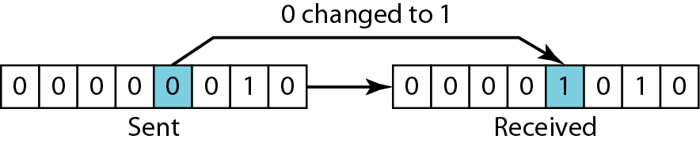
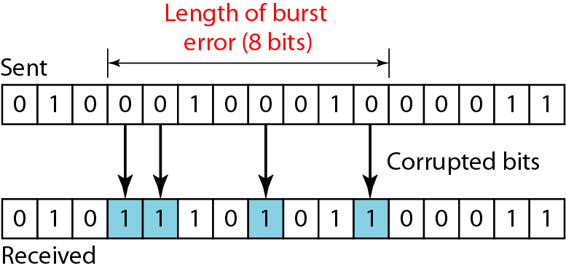
Types of Errors
Single bit error is only 1 bit in the data unit has changed
least likely type of error in serial data transmission
In a burst error, 2 or more bits in the data unit get changed
The length of the burst is measured from the first corrupted bit to the last corrupted bit. OR distance between the first and last errors in data block

Slide 4
Redundancy: Central concept in detecting /correcting errors
Need to send extra (redundant) bits with the data
Extra bits are added by the sender and removed by the receiver
Presence of redundant allows receiver to detect or correct corrupted bits
Coding: Various coding schemes to achieve redundancy
The sender adds redundant bits through a process that creates a relationship between the redundant bits and the actual data bits
The receiver checks the relationships between the two sets of bits to detect or correct the errors
In any coding scheme, the ratio of redundant bits to the data bits and the robustness of the process are important factors

Slide 5
Detection Versus Correction
Error detection concerns only to see if any error has occurred
Simply Yes or No
Even not interested in the number of errors (corrupted bits)
Single bit error is same as the burst error
Error correction: need to know the exact number of corrupted bits and their location in the message (more important)
The number of the errors and the size of the message are important factors
In an 8 bit data
To correct a single bit error, need to consider eight possible error locations
To correct two errors, need to consider 28 possibilities or combinations
Imagine the receiver's difficulty in finding 10 errors in a data unit of 1000 bits

Slide 6
Error Correction Methods
Forward error correction
The receiver tries to guess the message by using redundant bits if the number of errors is small
Correction by retransmission
A technique in which the receiver detects the occurrence of an error and asks the sender to resend the message
Resending is repeated until a message arrives error free (as per believe of the receiver)

Slide 7
Coping with Data Transmission Errors
Error detection codes
Automatic repeat request (ARQ) protocols
Correction by Retransmission
Error correction codes, or forward correction codes (FEC)
Correction at receiver

Slide 8
Error Control Requirements
The most common techniques for error control are based on some or all of the following ingredients:
Error detection
Receiver detects errors and discards PDUs in error
Positive acknowledgement
Destination returns acknowledgment of successfully received, error-free PDUs
Retransmission after timeout
Source retransmits unacknowledged PDUs after a predetermined amount of time
Negative acknowledgement and retransmission
Destination returns negative acknowledgment to PDUs in which an error is detected
The source retransmits such PDUs

Slide 9
Error Detection Codes
Data are transmitted as one or more contiguous sequences of bits, called frames
Data transmission can contain errors (single bit or burst)
Error detection codes detects the presence of an error
How to detect errors?
If only data is transmitted, errors cannot be detected
Send more information with data that satisfies a special relationship 🡪 Add redundancy
Error-detecting codes are commonly used in link, network, and transport layers

Slide 10
Error Detection Process
Transmitter
For a given frame of bits , the transmitter adds additional bits that constitute an error-detecting code
an error-detecting code (check bits) is calculated from transmitted (data) bits
Check bits are appended to data bits
Receiver
Separates incoming frame into data bits and check bits
Calculates check bits from received data bits
Compares calculated check bits against received check bits
A detected error occurs if and only if there is a mismatch

Slide 11
Error Detection Codes Parity Check
Parity bit (a single bit) appended at the end of data block
Even parity
Added bit ensures an even number of 1s
Odd parity
Added bit ensures an odd number of 1s
Example, 7-bit character [1110001]
Even parity [11100010]
Odd parity [11100011]

Slide 12
Parity Check
If the transmitter is transmitting 1110001 and using odd parity
It will append a 1 and transmit 11100011
The receiver examines the received character and if the total number of 1s is odd
No error
If 1 bit or any odd number of bits is inverted during transmission, For example,
Then the receiver will detect an error
Performance:
Detects all odd-number errors in a data block (1,3,5,…bits in error)
Detects NO errors that flip an even number of bits (2, 4, 6, … bits in error)

Slide 13
Flow Control and Automatic Repeat Request (ARQ)

Slide 14
Flow Control
A technique for assuring that a transmitting entity does not overwhelm a receiving entity with data
The receiving entity typically allocates a data buffer of some maximum length for a transfer
When data are received, the receiver must do a certain amount of processing (e.g., examine the header) before passing the data to the higher-level software
In the absence of flow control
the receiver's buffer may fill up and overflow while it is processing old data

Slide 15
ARQ and Flow Control
ARQ is a mechanism used in data link control and transport protocols
relies on the use of an error detection code, such as CRC
It is a protocol for error control in data transmission
Uses acknowledgements (ACKs) and timeouts to achieve reliable data transmission over unreliable service
NOTE: Block of data transmitted from one protocol entity to another is known as protocol data unit (PDU)

Slide 16
Automatic Repeat Request (ARQ) protocols
When the receiver detects an error in a packet
it automatically requests the transmitter to resend the packet
This process is repeated until
the packet is error free or
the error continues beyond a predetermined number of transmissions
In ARQ, only error detection capability is provided and no attempt to correct any packets received in error is made;
instead it is requested that the packets received in error be retransmitted
In its simplest form, ARQ leads to variable delays which are not acceptable for real-time services

Slide 17
Operation of ARQ
The transmitter
numbers the packets to be transmitted sequentially and
maintains a timer for each packet it transmits by using numbers from a finite set
The receiver
acknowledges, at the very least, the receipt of each successful packet by transmitting an ACK
Which bears the sequence number of the packet being acknowledged

Slide 18
Operation of ARQ
The packets for which the ACK is not received in predetermined time interval (timeout)
Are assumed to be lost and retransmitted
Negative ACK (NACK) by the receiver for packets received in error
A packet is retransmitted following the receipt of NACK

Slide 19
ARQ Protocols
Stop and Wait (SW)
DLC protocol transmits a packet only when all previously transmitted packets have been successfully acknowledged
The transmitter after transmitting a packet waits for its ACK
Next packet is transmitted after receipt of ACK
If no ACK arrives within timeout,
Packet is retransmitted
In SW, never more than a single packet unacknowledged at any given instant of time
the maximum data transfer rate that can be supported is limited
Since the transmitter does not use the available channel during time intervals it waits for an ACK

Slide 20
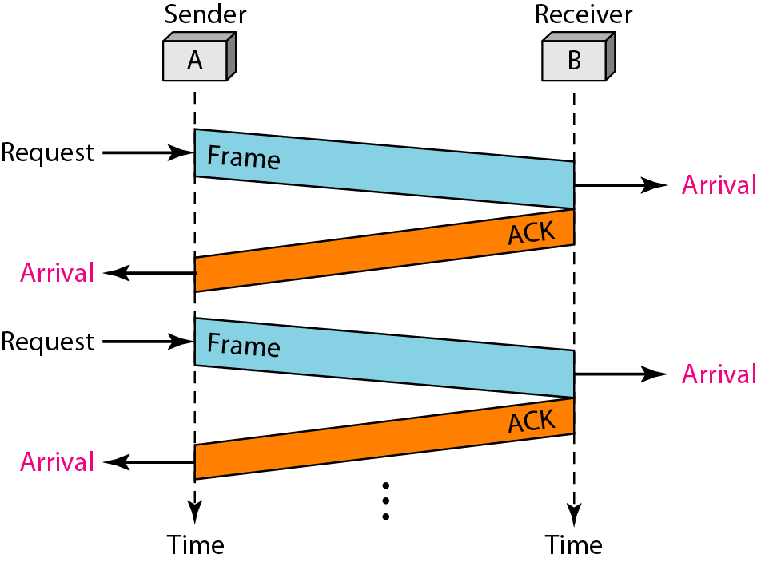
SW: Flow diagram for noiseless channel

Slide 21
An example of Stop-and-Wait ARQ for a noisy channel
Frame 0 is sent and acknowledged.
Frame 1 is lost and resent after the time-out.
The resent frame 1 is acknowledged and the timer stops. Frame 0 is sent and acknowledged, but the acknowledgment is lost.
The sender has no idea if the frame or the acknowledgment is lost, so after the time-out, it resends frame 0, which is acknowledged.

Slide 22
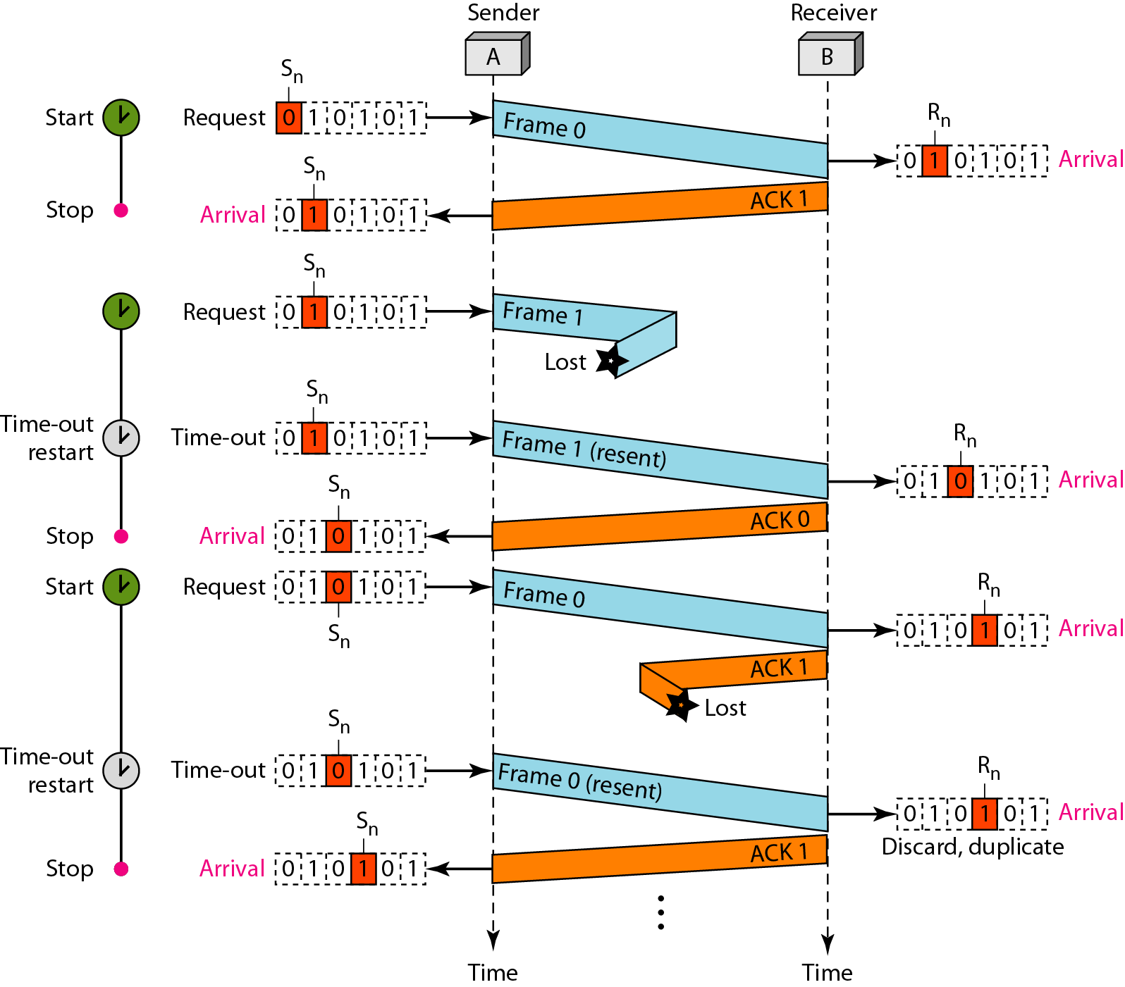
Flow diagram: SW ARQ for a noisy channel

Slide 23
ARQ Protocols
Selective Repeat (SR)
DLC layer transmits packets continuously when available
The receiver ACKs for each successfully received packet
Bearing the sequence number of the packet being ACKed
For non-receipt of ACK before the expiration of timeout
Packet is retransmitted
the transmitter resumes transmission of packets from where it left off
With SR ARQ protocol, packets are continuously transmitted
the inefficiency associated with SW is eliminated
But packets can be accepted out of sequence
Packets received out of sequence have to be buffered and sequenced before they can be delivered

Slide 24
ARQ Protocols
Go-Back-N
packets are transmitted continuously as in SR
But at the receiver, the DLC layer accepts packets only in the order in which they were transmitted
Packets received out of sequence are discarded and not acknowledged
Since the receiver accepts packets only in-sequence
after a timeout,
the transmitter retransmits the packet that timed out and
all packets with sequence numbers following the retransmitted packet

Slide 25
ARQ Protocols
Go-Back-N
Hence, for each timeout, all packets that are yet to be acknowledged are retransmitted
packets are transmitted continuously as in SR
But without the need to buffer out of sequence packets
Hence, there is no resequencing overhead

Slide 26
Error Correction Codes

Slide 27
Error Correction Codes
Error detection is found a useful technique in data link control protocols and in transport protocols (TCP)
Error detection requires retransmission (using Automatic Repeat reQuest)
Detection inadequate for wireless applications
wireless links are notoriously noisy and error prone when compared to optical fibers
Bit error rate on wireless link can be high, results in a large number of retransmissions
Long propagation delay compared to transmission time
Without error-correcting codes, it would be hard to get anything through
We need error control mechanisms to detect and correct errors that occur in the transmission of PDUs

Slide 28
Forward error correction codes (FEC)
Designed to detect and correct errors
Widely used form of error correction code
Block error correction codes
Follow the same general layout as in error detection codes
Take as input k-bit block, add r = n-k bits to produce n bit-block

Slide 29
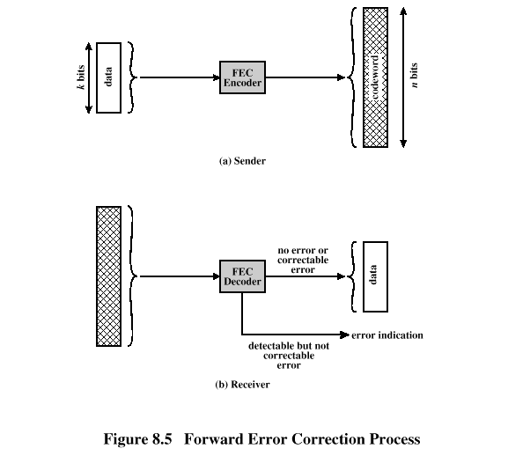
Forward Error Correction Process
FEC Decoder Outcomes
When a block is passed through FEC, possible outcomes
No errors present
Input to the FEC decoder matches original codeword
Decoder produces the original data block as output
Decoder detects and corrects bit errors for certain error patterns
Decoder detects but cannot correct bit errors for certain error patterns
Decoder simply reports uncorrectable error
Decoder detects no bit errors (for rare error patterns), though errors are present

Slide 30
Hamming Code Process
Encoding: k data bits + (n -k) check bits
Decoding: compares received (n -k) bits with calculated (n -k) bits using XOR
Resulting (n -k) bits called syndrome word
Syndrome range is between 0 and 2^{(n-k)}-1
Each bit of syndrome indicates a match (0) or conflict (1) in that bit position

Slide 31

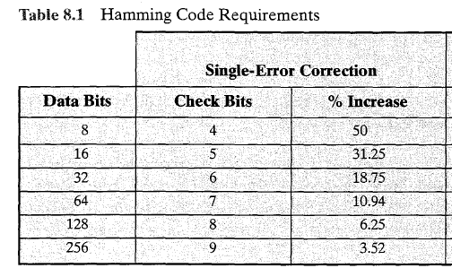
Hamming Code
number of bits needed to correct a single bit error in a word containing k data bits

Slide 32
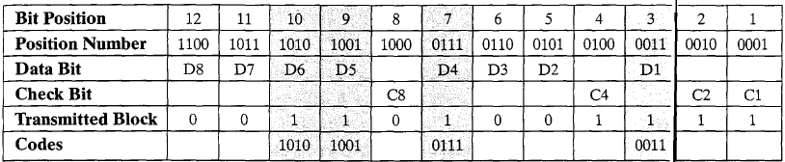
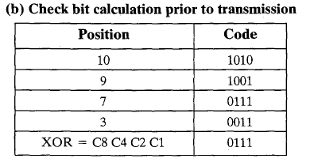
Hamming Code: Example
Consider 8 bit data block 00111001
we need 4 check bits
Transmitted Block
Check bits (hamming code) are to be added at positions 1,2,4,8,…
By taking XOR of data bits having value 1 (here, four data bits have value 1). Here, we get 0111 Hamming code
So transmitted block is: 001101001111

Slide 33
8bit: 00111001
B# | 12 | 11 | 10 | 9 | 8 | 7 | 6 | 5 | 4 | 3 | 2 | 1
P# | 1100 | 1011 | 1010 | 1001 | 1000 | 0111 | 0110 | 0101 | 0100 | 0011 | 0010 | 0001
D | D8 | D7 | D6 | D5 |  | D4 | D3 | D2 |  | D1
C |  |  |  |  | C4 |  |  |  | C3 |  | C2 | C1
Tr | 0 | 0 | 1 | 1 | 0 | 1 | 0 | 0 | 1 | 1 | 1 | 1
Code |  |  | 1010 | 1001 |  | 0111 |  |  |  | 0011
1010 0111 0011
1001 0011 0100
0011 0100 0111

Slide 34
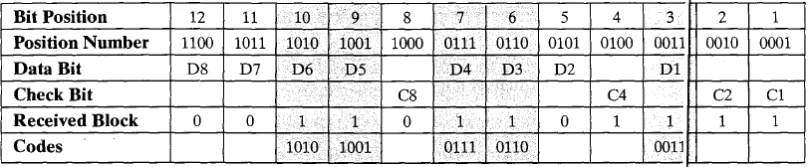
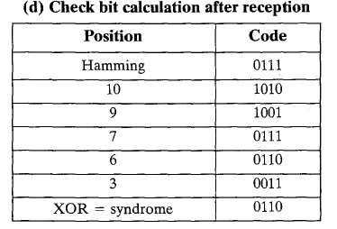
Hamming Code: Example
Now suppose Data bit 3 (at position 6) changes from 0 to 1
receiver receives the block as 001101101111
Hamming code is still the same
Receiver performs XOR of hamming code and all of the bit position values for non-zero data bits with a result of 0110 (indicates there is error at in bit position 6)

Slide 35
Syndrome characteristics
If the syndrome contains all 0s, no error has been detected
If the syndrome contains one and only one bit set to 1
then an error has occurred in one of the check bits
No correction is needed
If the syndrome contains more than one bit set to 1
then the numerical value of the syndrome indicates the position of the data bit in error
This data bit is inverted for correction

Slide 36
8 bit block 00110100
Check bits: 0101
Transmitted block: 001100101001
2nd part
If the transmitted block received to receiver is 001110101001. Find the error bit position.

